Slide 1
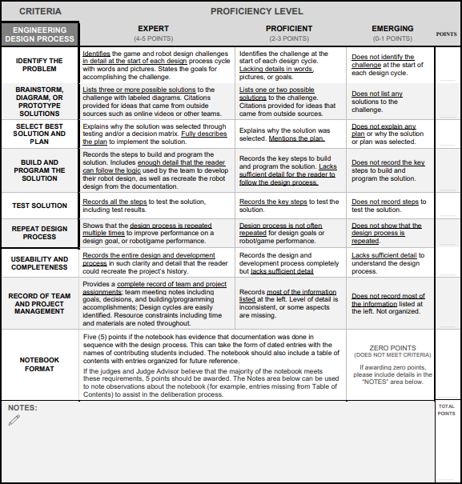
`

Slide 2

THE TEAM
Team Introductions
We are Team 30004C from Alpharetta Georgia. All of us have been in the Vex IQ Robotics program for 2 years, and since we’ve started, we’ve learned more and more about Vex IQ Robotics. We try our very best in everything we do, and this, year, we hope to apply the skills we have learned over the years in this year’s Vex IQ Robotics competition, “Full Volume”.
Sanchit Bhadani
Grade: 8th
Experience with Vex IQ: 2 years
Roles: Head Designer, Support Builder,
Co-Notebooker, Co-Strategist

Slide 3


Parth Gupta
Grade: 8th
Experience with Vex IQ: 2 years
Roles: Support Designer, Support Builder,
Co-Notebooker, Head Programer
Vishnu Tadipatri
Grade: 8th
Experience with Vex IQ: 2 years
Roles: Support Designer, Head Builder,
Co-Notebooker, Co-Strategist, Support Programmer

Slide 4
THE TEAM
Team Goals
Goal 1:
We want to learn more about Vex IQ Full Volume throughout the year to help us make a well-working game strategy, as well as a distinguished robot design. We also want to establish great teamwork and planning skills during our time in the Full Volume Competition.
Goal 2:
We want to create a unique, yet well-functioning robot using robot designing resources such as CAD (Computer-Aided Design), Microsoft Whiteboard and other planning sources. We also want to establish great robot driving skills and working autonomous code, that can be used to score a plethora of points in the game.
Goal 3:
We hope to get awards from our regional competitions such as the Excellence Award, the Design Award, and the Skills and Team Matches awards.
Goal 4:
We want to get into the Georgia State competition with a high scoring robot and a proficient game strategy. We also hope to earn awards from the State competition to possible get into Nationals.
Goal 5:
We hope to get into Nationals with an efficient, high scoring robot and a well functioning game strategy.

Slide 5
THE NOTEBOOK
Reading Key
Title
This font will be used for titles
Subtitle
This font and format will be used for subtitles
Heading
A phrase within a box will indicate a heading within a section
Subheading
A phrase within a rounded box will indicate a heading within a section
Highlighted Sentences
Phrases or sentences highlighted in yellow indicate that they are important
LABELS
Labels will be in all capital letters, and are used in pictures, diagrams, or sketches
(Notebook #,
Page #, Heading)
This format will be used when referencing to a certain section of the notebook
Normal text
This font and font size will be used for normal text

Slide 6
DESIGN PROCESS
The 5 Steps
1 - Identify Problem:
State the goal and the problem
Describe the problem in detail using words, and diagrams
List solution restrictions and requirements
List solution goals
2 - Brainstorm Solutions
State the goal
List numerous solutions for the problem
Create “Positives and Negatives” charts for each solution
Create diagrams for each solution
List citations for ideas coming from outside sources
3 - Select Solution and Plan:
Create prototypes for the best solutions to the problem
Test prototypes for efficiency, effectiveness, ect.
Sketch the final solution
Create a CAD model of the solution
4 - Build Solution:
List parts needed to build the solution
Describe the steps to build the solution
Complete the solution
5 - Test Solution:
List steps to test the solution
Describe the test results
Create a final conclusion based on the results

Slide 7
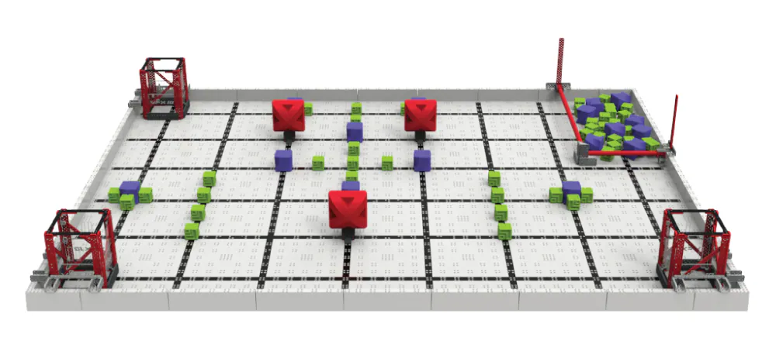
IDENTIFY GAME PROBLEM
VEX IQ Full Volume
Goal
We will analyze “VEX IQ Full Volume” so we can understand the competition more thoroughly.
Game Elements
Supply Zone
Length: 14.1 in
Width: 28.1 in
Height of Bar: 2.4 in
Area: 396.21 in^2
Quantity in Field: 1
Number of Blocks at Start of Game: 31 (8 Purple, 23 Green)
Cleared Supply Zone: 20 Pts
Partially Parked Robot: 5 Pts
Fully Parked Robot: 10 Pts
The Supply Zone is an area in the VEX IQ Full Volume Field where alliances can remove blocks to either score them or earn the 20 point bonus. At the end of the match, players can partially or fully park in the Supply Zone to earn an additional bonus.

Slide 8
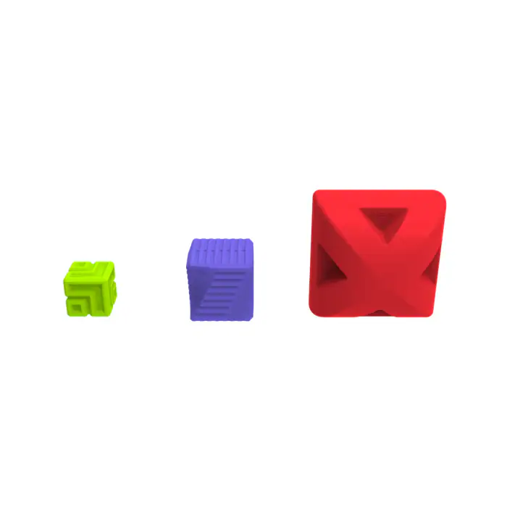
Scoring Goals
The goals are areas in the VEX IQ Full Volume field where the blocks can be scored for a single point. Also, each goal has 2 additional fill levels, with a 10 point bonus for every fill level. If all the blocks in the goal are the same color (uniform), the alliance earns a 10 point bonus.
Length: 6 in
Width: 6 in
Height: 10 in
Volume: 360 in³
Quantity in Field: 3
Block Scored in Goal: 1 Pt
Uniform Goal: 10 Pts
Height Bonus: 10 Pts per level shared by all three goals
Red Block
Green Block
Purple Block
Shape: Spherical Cube
Weight: 180g ± 2
Side Length: 5.8 in
Quantity in Game: 3
Shape: Cube
Weight: 30g ± 2
Side Length: 2 in
Quantity in Game: 54
Shape: Cube
Weight: 45g ± 2
Side Length: 3 in
Quantity in Game: 16
Points Earned From Starting Peg Removal: 5 Pts
The 3 types of blocks all score 1 point each when in the goal. There are 73 blocks in total, with 31 blocks in the Supply Zone.

Slide 9
Important Terms
Game Objects
Block – A green, purple, or red plastic scoring object.
Goal – A rectangular-shaped structure built out of VEX IQ parts and clear plastic sheets and connected to a corner of the Field. The VEX IQ parts used to connect a goal to the field are not considered part of the goal.
Starting Peg – One of 3 Field Elements used for setting up red blocks at the beginning of a match.
Supply Zone - An infinitely tall three-dimensional volume of the field bordered by the outer edges of the red PVC pipe and the outer edges of the field perimeter.
Match Play
Cleared – A Supply Zone status. The Supply Zone is considered cleared if no blocks are fully within the 3D volume of the Supply Zone at the end of the match.
Fill Level – A goal attribute that corresponds to the “highest” block(s) scored in a given goal. A goal can have one of three possible fill levels as described below; if a Goal meets the requirements for multiple fill levels, it should be assigned the highest of those fill levels. Fill levels are used to determine the overall height bonus at the end of the match.

Slide 10
Height Bonus – An additional point bonus awarded at the end of the match based on the fill level of the goals.
Parked – A robot status at the end of the match.
• Partially Parked – A robot is partially parked if any part of it is within the Supply Zone.
• Fully Parked – A robot is fully parked if it is fully within the Supply Zone.
• Double Parked – An alliance is double parked if both robots are fully parked.
Scored – A block status. A block is considered to be scored if it is in a goal.
Removed - A red block status. A red block is considered removed if it is no longer fully supported by a starting peg at the end of the match.
Uniform - A goal status. A goal is considered Uniform if all the blocks in the goal of are the same type.

Slide 11
GAME RULES
VEX IQ Full Volume
Goal
We will understand the Vex IQ Full Volume rules to help us develop strategies for this year’s game.
<SG1> Pre-match setup: At the beginning of a match, each robot must meet the following criteria:
1. Not contacting any blocks, goals or their supporting structure, starting pegs, or other robots.
2. Fit within an 11” wide x 20” long x 15” high (279mm x 508mm x 381mm) volume, as checked during inspection.
3. Contacting the inside and/or top face of the field perimeter wall that is between goals 2 and 3. See Figure 18.
4. Have no motors or other mechanisms in motion or “running” until the match begins.
<SG2> Horizontal expansion is limited during a match. Robots may not expand horizontally beyond the 11” x 20” starting dimension limit at any time during a match.
<SG3> Keep blocks in the field. Blocks that leave the field during a match may be returned to the Supply Zone by a driver or referee. Any blocks which remain outside of the field at the end of a match will be considered “in” the Supply Zone (i.e., the Supply Zone will not be eligible to be Cleared).
Notes:
ies084qmisc

Slide 12
<SG4> Blocks are randomly loaded in the Supply Zone. Prior to each match, the Supply Zone will be filled randomly with eight (8) purple blocks and twenty-three (23) green blocks.
a. Blocks will be randomly mixed by a field reset volunteer and/or the head referee.
b. Blocks must be placed such that one face of each block is “flat” on the floor (i.e. not “stacked” or “tilted’). See images throughout this Game Manual for examples.
c. Team members may not touch blocks in the Supply Zone during pre-match setup. Any contact will result in a re-randomization of the Supply Zone by the head referee.
Violations
Violation - The act of breaking a rule in the Game Manual.
Minor Violation – A violation which does not result in a disqualification.
Major Violation – A violation which results in a disqualification.
Score Affecting – A violation which improves an alliance’s score at the end of the match.

Slide 13
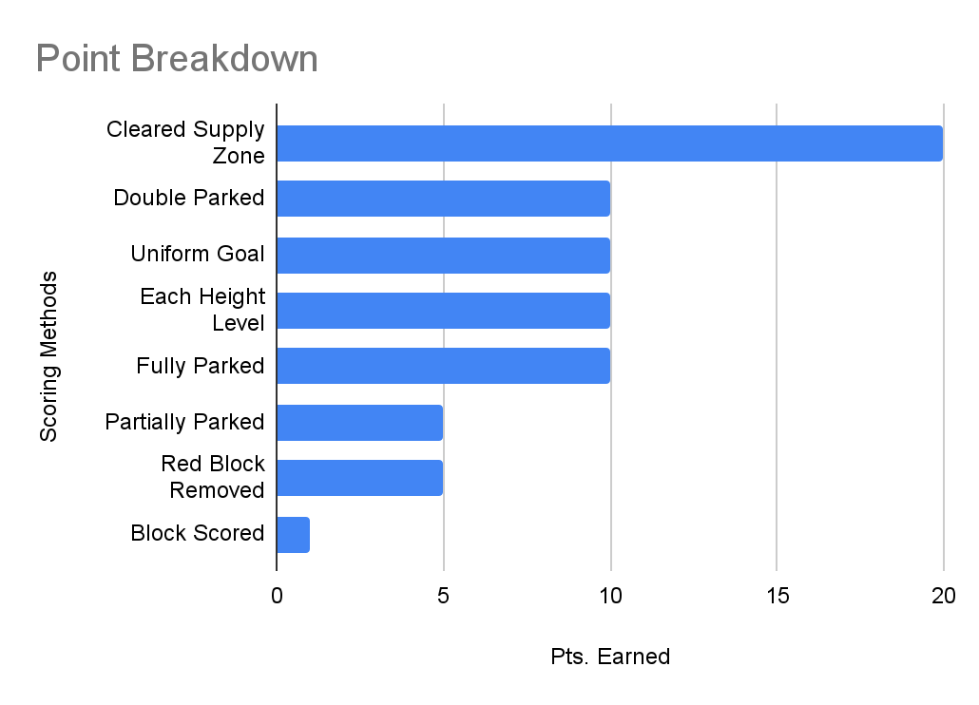
GAME STRATEGIES
VEX IQ Full Volume
Goal
We will create and develop strategies for this year’s game so we can learn the best ways to score a high number of points.
Scoring Prioritization
There are 7 ways to earn points in VIQC Full Volume :
1 pt from each block scored in goal
10 pts for each uniform goal
10 pts for every height level in the goal if all goal meet the level
20 pts for a cleared Supply Zone
5 pts for each red block removed from starting peg
5/10 pts for a partially/fully parked robot (respectively)
10 pts for a double parked alliance
Observations
A cleared Supply Zone is the task that awards the most points
A block in the goal awards the least amount of points
Notes:
ies084qmisc

Slide 14
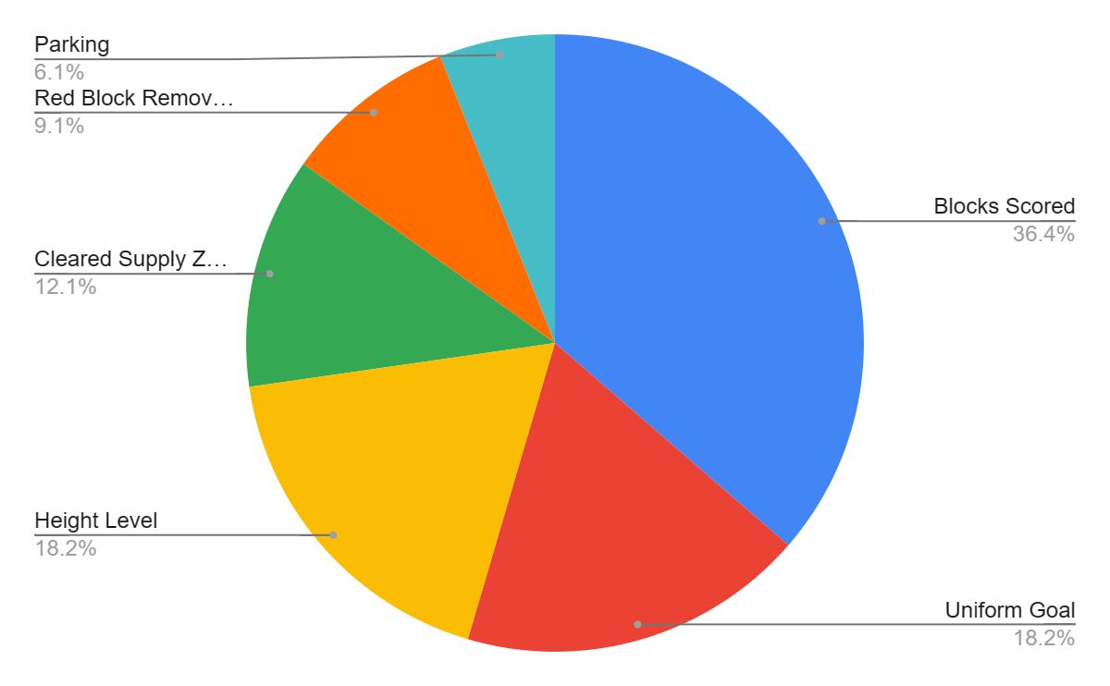
Total Points
To find out the number of points that each task can award, we have to take into account that:
Up to 45 green blocks can fit in a single goal
Up to 13 purple blocks can fit in a single goal
Up to 2 red blocks can fit in a single goal
There are only 3 goals on the field
We can either partially park or fully park
It is impossible to score all blocks on the field
From this, we can calculate that the scenario that would award the most points (without taking time into account) in a skills match is:
45 green blocks in 1 goal
13 purple blocks in 1 goal
2 red blocks in 1 goal, but all 3 were knocked down
Robot is fully parked
Cleared Supply Zone
Total is 165 pts.
Observations
Scoring the blocks in the goals earns the most points
Parking earns the least points

Slide 15
Scoring Strategies
Score 3 Red Blocks Across 2 Goals and 22 Green Blocks in 3rd Goal
Positives | Negatives
2nd fill level bonus is achieved 2 uniform goals scored 80 points scored | Time sensitive Robot must have large storage to carry red blocks Robot must be able to intake green cubes at a fast rate
Score 2 Red Blocks in 1 Goal and 22 Green Blocks Across 2nd and 3rd Goal
Positives | Negatives
2nd fill level bonus is achieved 3 uniform goals scored 89 points scored | Time sensitive Robot must have large storage to carry red blocks Robot must be able to intake green cubes at a fast rate
Score 3 Red Blocks Across 2 Goals and 6 Purple Blocks in 3rd Goal
Positives | Negatives
2nd fill level bonus is achieved 2 uniform goals scored Not time sensitive 64 points scored | Robot must have large storage to carry red blocks Scores low amount of points

Slide 16
Score 2 Red Blocks in 1 Goal and 6 Purple Blocks Across 2nd and 3rd Goal
Positives | Negatives
2nd fill level bonus is achieved 3 uniform goals scored Not time sensitive 73 points scored | Robot must have large storage to carry red blocks Scores average amount of points
Score 6 Purple Blocks in 1 Goal and 22 Green Blocks Across 2nd and 3rd Goal
Positives | Negatives
2nd fill level bonus is achieved 3 uniform goals scored 93 points scored | Time sensitive Robot must have intake(s) capable of intaking green AND purple blocks
Score 6 Purple Blocks Across 2 Goals and 22 Green Blocks in 3rd Goal
Positives | Negatives
2nd fill level bonus is achieved 3 uniform goals scored 93 points scored | Time sensitive Robot must have intake(s) capable of intaking green AND purple blocks
Conclusion
Using Strategies #2, #5 and #6 will earn us the most points. However, they have negatives that may be challenging to solve. Strategy #3 earns the least points but has very little negatives.

Slide 17
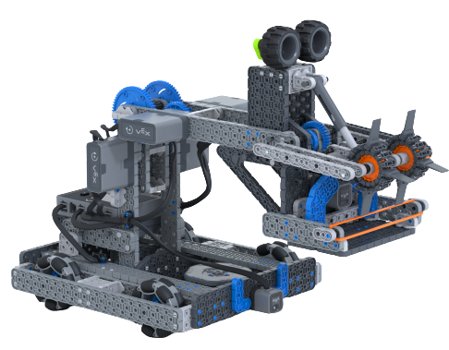
HERO BOT “BYTE”
VEX IQ Full Volume
Goal
We will analyze Hero Bot “Byte” so we can use its strengths and eliminate its weaknesses in our robot.
Byte’s Structure and Gameplay
Diagram of Byte
INTAKE-MOTORS
GEAR RATIO
STORAGE
ARM-MOTORS
OMNI-WHEELS
SENSORS
Byte’s Structure
COUNTERWEIGHT
Byte is made of three major subsystems; the drivetrain, arm, and intake. The drivetrain is made of 4 omni-wheels, two motorized in the back and two free spinning in the front. The arm simply turns clockwise or counterclockwise, with a 1:5 gear ratio to assist the motors. Lastly, the intake uses two motors to hold 2 green or 1 purple block. Byte also uses a counterweight to balance the robot, and 2 sensors to assist with drive control or autonomous programming.

Slide 18
Byte’s Gameplay
Because we don’t have access to what Byte’s intended gameplay was, we are going to infer from the the structure of Byte. Byte’s gameplay is very simple.
Byte simply grabs 1 purple or 2 green blocks from the field and scores the blocks repeatedly. At the end of the match, Byte can partially park.
Analysis of Byte’s Major Subsystems
Drivetrain
Positives | Negatives
Turns quickly Aligns with field perfectly High Control over driving | Center of gravity is dislocated Low Speed
Arm
Positives | Negatives
Can reach into Supply Zone Has high torque Can reach to top of goals | Can’t reach far into Supply Zone Can’t fully park the robot

Slide 19
Intake
Positives | Negatives
Can grab from the Supply Zone Grabs and releases blocks | Can only grab a few blocks Can’t grab red blocks
Conclusion
Our goal was to analyze Byte so we can use it’s strengths and eliminate it’s weaknesses in out robot. After looking at Byte’s structure and gameplay, we come to see that Byte’s drivetrain might be very helpful in the game, because the high agility and low speed can help navigate through the cramped field. On the other hand, the arm and intake won’t be very helpful because of the inefficient gameplay that is used by these mechanisms. All in all, Hero Bot Byte is great starting point, but definity not our go-to bot.

Slide 20
DRIVETRAIN FORECAST
Time Management
Goal
We will create a timeline to manage our time efficiently and finish our robot before the competition takes place. This is our GOAL for building the drivetrain. This timeline will be flexible.
Selection & Build Drivetrain Completed: 9/5-9/7
Identify Problem: 8/31
Drivetrain Completed: 9/9
Brainstorm Solutions: 9/3
Test Drivetrains: 9/8

Slide 21
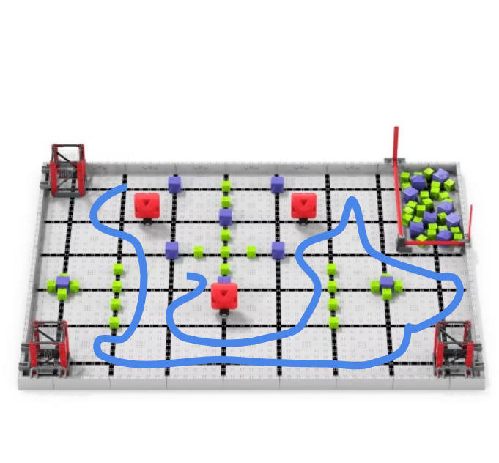
Identify Problem
Drivetrain Build
Goal
We want to create a drivetrain that shows effectiveness in the VEX IQ Full Volume Game.
Problem
Solution Requirements/Limits
The problem is that there is not much space in the field to move. This makes it hard to interact with game elements/objects.
We can only use VEX IQ Legal parts.
Fits within an 11” wide x 20” long parameters
At most, 6 motors of use
Solution’s Goals
The drivetrain should travel through the field in at most, 6 seconds, to minimize time
The drivetrain should be agile
The drivetrain should be fast and have enough torque to handle the robot’s weight
The blue lining in this picture shows the driving area or driving space in the Full Volume field.
Notes:
8/31

Slide 22
Drivetrain Brainstorm
Drivetrain Build
Goal
We want to brainstorm drivetrain ideas, based on our game problem, and the solutions we created.
Drivetrain Base Types
Standard/Flat Drivetrain (Rear Wheel Drive)
Most common, in robots
Motors in the BACK
Positives | Negatives
Fast Less Motors Easy for programming | No speed or torque ratios Lots of Back-Drifting
Standard/Flat Drivetrain (Front Wheel Drive)
Not common
Motors in the FRONT
Positives | Negatives
Fast 2 motors | No speed or torque ratios Lots of Front-Drifting
Notes:
ies084qmisc

Slide 23
Drivetrain Types (Continued)
Standard/Flat Drivetrain (All Wheel Drive)
Most common, in robots
Motor per Wheel
Positives | Negatives
Fast Agile | No speed or torque ratios Hard to program Lots of motors
Tri-Train Drive (Middle Motor)
Motor in the middle, connected to wheels by chain
Positives | Negatives
Fast Better drift handling Compatible with gear ratios | Harder to turn Reduces available space throughout the middle of robot

Slide 24
Drivetrain Sketches
Standard/Flat Drivetrain (All-Wheel Drive)
Tri-Train Drivetrain
Standard/Flat Drivetrain (Front Wheel Drive)
Standard/Flat Drivetrain
(Rear Wheel Drive)
KEY:
Blue = Chain
Yellow = Wheels
Green = Motors

Slide 25
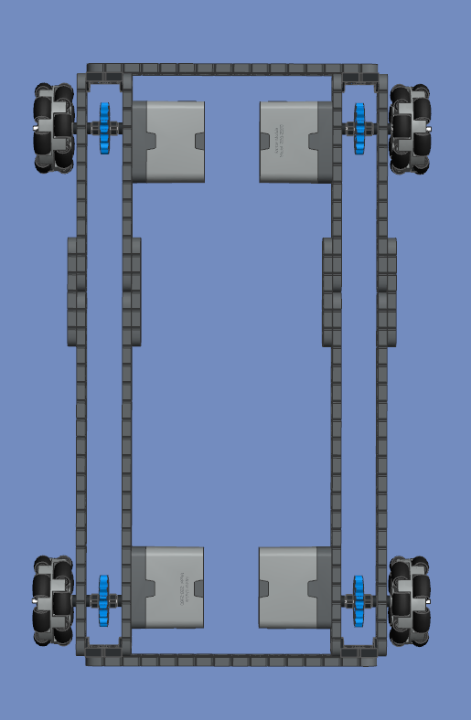
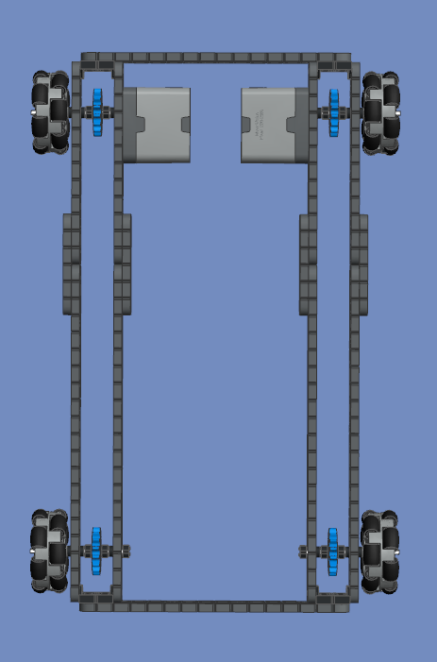
Drivetrain (CAD Models)
AWD (All-Wheel Drive)
RWD (Rear-Wheel Drive)

Slide 26
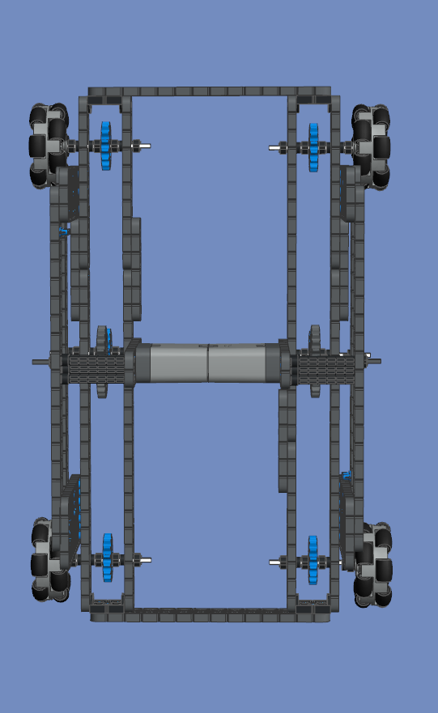
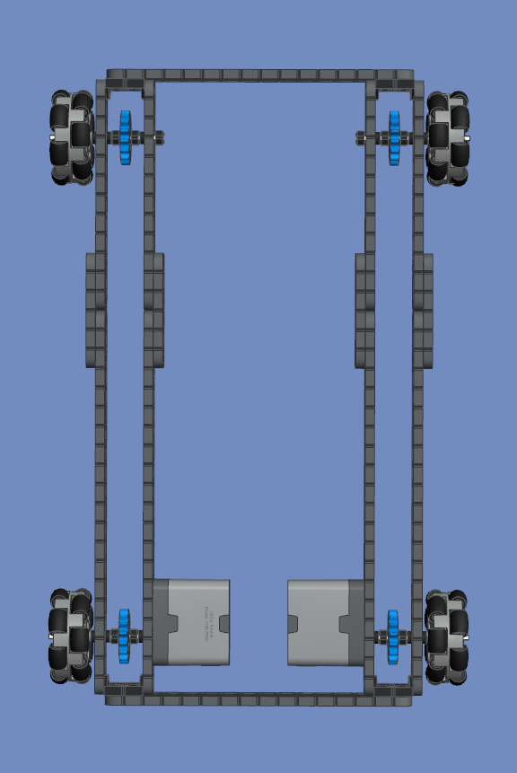
Drivetrain (CAD Models)
Tritrain Drive
FWD (Front-Wheel Drive)

Slide 27
Drivetrain Brainstorm
Wheel Types
Goal
We want to brainstorm drivetrain ideas, based on our game problem, and the solutions we created.
Wheel Types
Traction Wheel (Traction 200mm Wheels)
Common drivetrain
One direction wheels
Positives | Negatives
Fast Simple Less Motors | Only moves in 1 direction Not agile
Omni Wheel (200mm Omni Wheels)
Most Common Drivetrain
2 direction wheels
Positives | Negatives
Fast Simple Less Motors Moves in 2 directions | Less Traction/More Drifting Not as durable
Notes:
9/3

Slide 28
#1 Hybrid Wheel (2 Traction for Front, and 2 Omni for Back)
Uncommon Drivetrain
“Crossbred” Drive
Positives | Negatives
Fast Less Motors | Complex Lots of Back-Drifting Wrong Center of Gravity
#2 Hybrid Wheel (2 Omni for Front, and 2 Traction for Back)
Uncommon drivetrain
“Crossbred” Drive
Positives | Negatives
Fast Less Motors Agile | Complex More Programming Wrong Center of Gravity
Notes:
9/3

Slide 29
Wheel Sketches
Hybrid (Traction in the back, Omni in the front) Wheel Set
Full Traction Wheel Set
Hybrid (Omni in the back, Traction in the front) Wheel Set
Full Omni Wheel Set
KEY:
Blue = Traction
Red = Omni
Notes:
9/4

Slide 30
Drivetrain Brainstorm
Gear Ratio
Goal
We want to brainstorm drivetrain ideas, based on our game problem, and the solutions we created.
Gear Ratios
1:1 Neutral Gear Ratio
More common drivetrain
Has neutral speed and torque gainage
Positives | Negatives
Has moderate speed and torque | Doesn’t have speed gainage Doesn’t have torque gainage
2:1 Speed Gear Ratio
Uncommon drivetrain
2x the speed of a neutral drivetrain
Positives | Negatives
Is very fast and agile | Very low torque Very low control
Notes:
9/4

Slide 31
3:2 Slight Speed Gear Ratio
Uncommon drivetrain
1.5x the speed of a neutral drivetrain
Positives | Negatives
Is fast and agile | Low torque Low Control
2:3 Slight Torque Ratio
Very uncommon drivetrain
1.5x the torque of a neutral drivetrain
Positives | Negatives
Can hold lot of weight and power heavy-duty mechanisms High torque High Control | Low speed Low agility

Slide 32
DRIVETRAIN Forecast
*UPDATED*
Goal
We will create a timeline to manage our time efficiently and finish our robot before the competition takes place. This is our updated GOAL for building the drivetrain. This timeline will be flexible.
Selection & Build Drivetrain Completed: 9/9
Identify Problem: 8/31
Drivetrain Completed: 9/10
Brainstorm Solutions: 9/3
Test Final Drivetrain: 9/10

Slide 33
Select and Plan
Drive Types
Goal
We will choose the best drivetrain to meet our needs through a decision matrix.
Drivetrain Type: Decision Matrix
To decide what type of drivetrain we are going to be using, we have to consider:
Control: How easy is it to control the robot?
Size: How small or big is the robot?
Adaptability: Can the robot be changed?
Compatibility: Is it durable?
Energy Consumption: How much workload do the motors take up?
Chart
Ranking the drivetrains on a scale from 1-5. *Some words might have abbreviations
 | Control | Size | Adapt. | Durability | Energy Cons.
FWD | 2; Terrible Center of Gravity | 5; Compact & low to ground | 3; Can be changed but hard to do so | 3; Less support for other subsystems | 5; Only 2 motors.
RWD | 3; Okay Center of Gravity | 5; Compact & low to ground | 3; Can be changed but hard to do so | 3; Less support for other subsystems | 5; Only 2 motors.
AWD | 5; Perfect Center of Gravity | 5; Compact & low to ground | 2; Hard to change the robot | 4; Better support for other subsystems | 2; 4 motors take a lot of energy up.
Tri Train | 4; Better center of gravity. | 4; Less compact and higher to the ground | 5; Only Gear-Ratio compatible drivetrain. | 5; Has a strong frame, to support other subsystems. | 5; Only 2 motors
Notes:
9/8

Slide 34
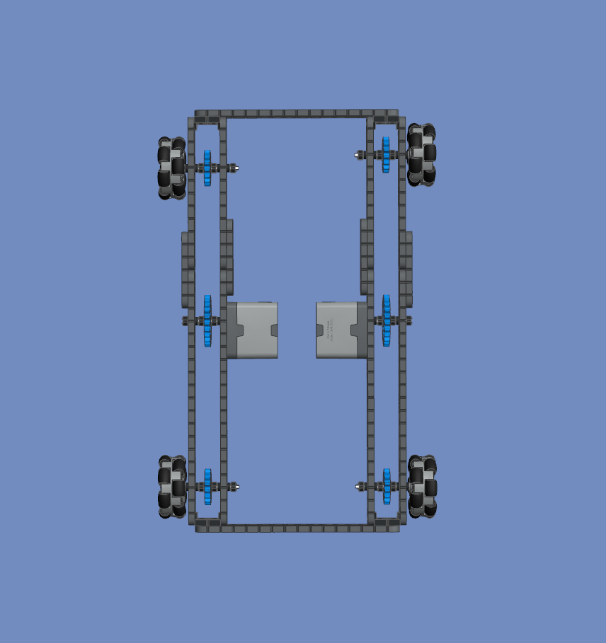
Conclusion
Through the decision matrix and grading each type of of drivetrain through five different factors, we have come to the conclusion that we should use the Tri-Train.
Modification
To try and fix the size problem of the Tri-Train, we have decided to move to motors down so we can minimize the amount of vertical space taken up by the drivetrain.
Notes:
8/30/2023

Slide 35
Select and Plan
Wheel Types
Goal
We will choose the combination of wheels on our robot to maximize efficiency and to meet our needs.
Wheel Type: Decision Matrix
To decide what wheel type we are going to be using, we have to consider:
Control: How easy is it to control the robot?
Speed: How fast will our robot drive?
Agility: How fast is the turning speed of the robot
Chart
Ranking the wheel types on a scale from 1-5. *Some words might have abbreviations
 | Control | Speed | Agility
Traction in back, Omni in front | 3; Hybrid wheels cause inconsistency while driving | 3; Half traction and half omni cause reduced speed | 2; Hybrid wheels make turning extremely inefficient
Full traction | 3; Rubber of the wheels create friction on the field, making control inconsistent | 5; Traction wheels have good grip on floor | 1; Traction wheels’ grip against the field makes turning very slow
Full Omni | 4; Wheels have average grip against field, increasing control | 3; Wheels have average grip against field, and therefore have average speed | 5; Wheels can move sideways without turning, making agility very efficient
Omni in back, Traction in front | 3; Hybrid wheels cause inconsistency while driving | 3; Half traction and half omni cause reduced speed | 2; Hybrid wheels make turning extremely inefficient
Notes:
9/8

Slide 36
Conclusion
Through the decision matrix and grading each wheel type through the three different factors, we have came to the conclusion that an all omni-wheel drivetrain would have the most efficiency and is the best option for our drivetrain.
Full Omni Wheel Set
Notes:
8/30/2023

Slide 37
Select and Plan
Gear Ratios
Goal
We will choose the best gear ratio to meet our needs through testing and a decision matrix.
Gearing Ratio: Listing Process
Here are the gear ratios that we will test:
1:1 (Neutral)
2:1 (2x Speed)
3:2 (1.5x Speed)
2:3 (1.5 Torque)
Chart
These are the things we are looking for:
Speed
Control
Agility
 | Speed | Control | Agility
1:1 (Neutral) | 5 | 8 | 7
2:1 (2x Speed) | 10 | 3 | 9
3:2 (1.5x Speed) | 8 | 5 | 8
2:3 (1.5 Torque) | 3 | 10 | 6
*We have decided that we will start our selection process with a decision matrix. Here, we will compare all of the ratios (before testing). This will give us an overview of what will be selected in the future. We will rank our data from 1 - 10.
Notes:
8/29/2023

Slide 38
Gear Ratios: General Testing
The second step in our selection process is testing. We are going to test 3 things: speed, torque, and agility. Below, we have listed the various ways we tested each.
These are the ways we tested each category:
Speed: We tested speed using TIME (in seconds). We drove the robot 150 inches (12.5 ft), and checked the time after reaching the end.
Torque: We tested torque by tieing a 5-pounds to the back of our robot using string. We then checked how much RPM the robot was driving at.
Agility: We tested agility using TIME (in seconds). We made 5 360° turns (1,800°), and measured how much time it took.
Note*: All tests utilized the default drive control program on the VEX IQ Generation 2 Brain.
Notes:
8/30/2023

Slide 39
Gear Ratios: General Testing Chart
 | Speed | Torque | Agility
1:1 (Neutral) | 14.3 Seconds | 51 RPM | 12.6 Seconds
2:1 (2x Speed) | 7.2 Seconds | 22 RPM | 9.5 Seconds
3:2 (1.5x Speed) | 9.7 Seconds | 32 RPM | 10.4 Seconds
2:3 (1.5x Torque) | 19.1 Seconds | 97 RPM | 18.9 Seconds
Gear Ratios: General Testing Conclusion
After using the data in the chart, we have decided to use a 3:2 Speed Ratio. This is because it is like a happy medium, when compared to the other 3 drivetrains. In addition, it has a lot of torque, it is easy to build, and it is fast, while being able to move nicely. It also has a lot of control, and can make sharp and precise turns. This gear ratio will fit our needs and be the optimal ratio for the Vex IQ Full Volume competition.
Notes:
8/30/2023

Slide 40
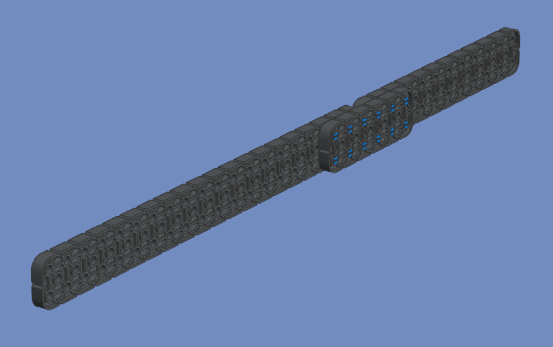
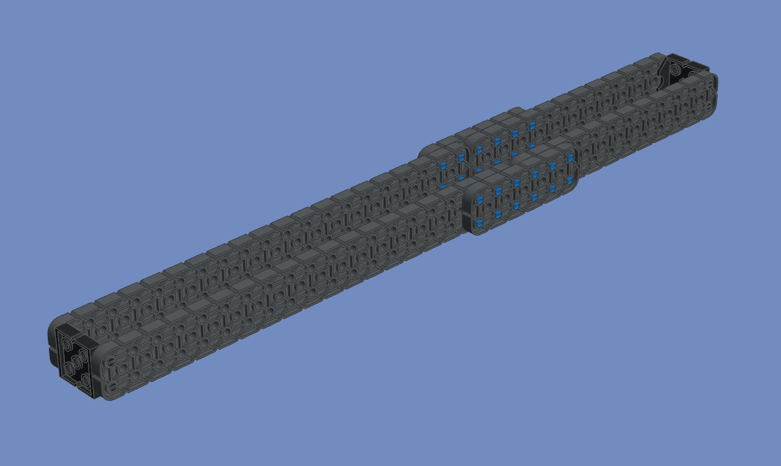
Build Solution
Drivetrain Assembly
Goal
We will list out the steps to build our final drivetrain as well as how we programmed the drivetrain to meet our needs.
Steps to Build Drivetrain
Attach 6 pegs to the end of the 2x20, and 6 pegs to the beginning of the 2x12. Attach both of these pieces together using a 2x6 connected to the pegs.
Attach 2 2x2 Vex Connecters to the end of the initial figure, and then attach a 2x20 and 2x12 to the connecters. Connect the 2x20 to the 2x12 using 12 pegs and a 2x6.
Notes:
9/10/2023

Slide 41
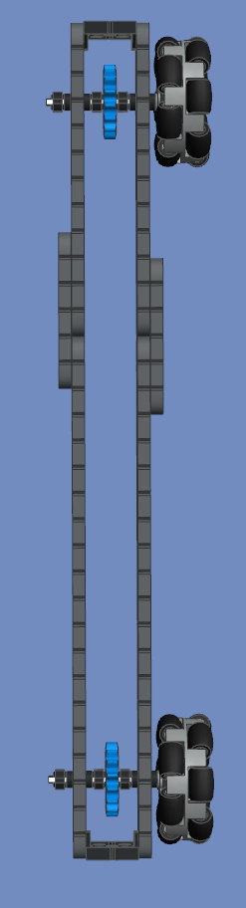
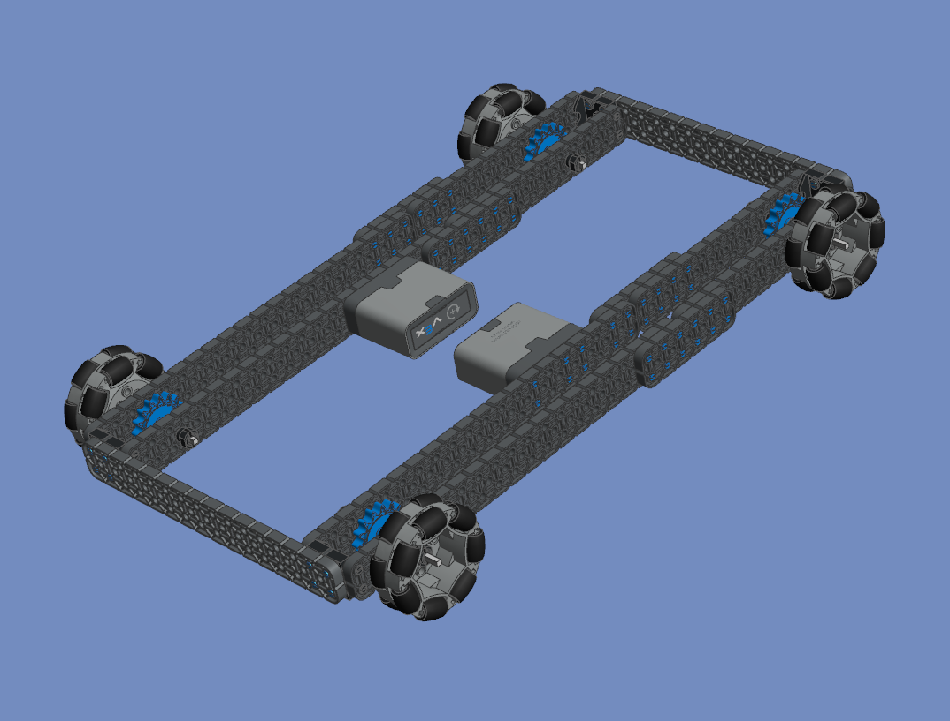
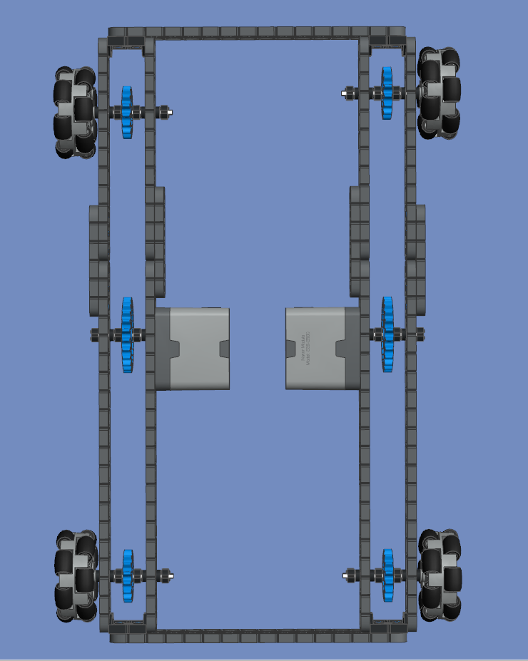
Slide an axle on either side of the drivetrain with a 16 tooth sprocket gear along with rubber axle bushes and washers. Attach the wheels on the side of the drivetrain.
Repeat steps 1-3 and then attach 4 pegs to each of the 4 2x2 Connecters. Connect the 2 drivetrains using a 2x16. Attach motors to the middle of either side of the drivetrain using pegs.
Slide an axle with a 24 tooth gear into the axel slot in the motor. Slide washers and rubber axle bushes alongside the gear.
Notes:
9/10/2023

Slide 42
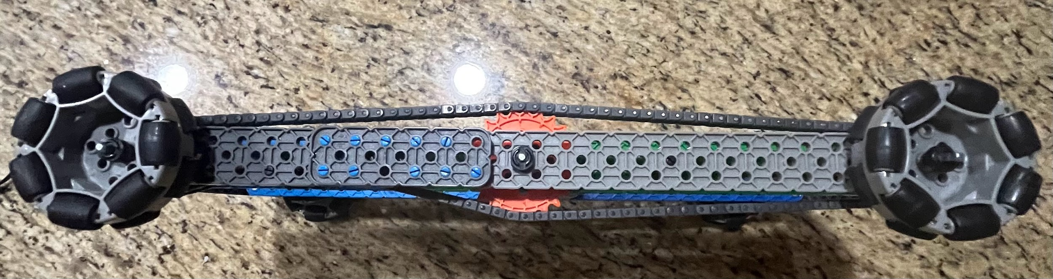
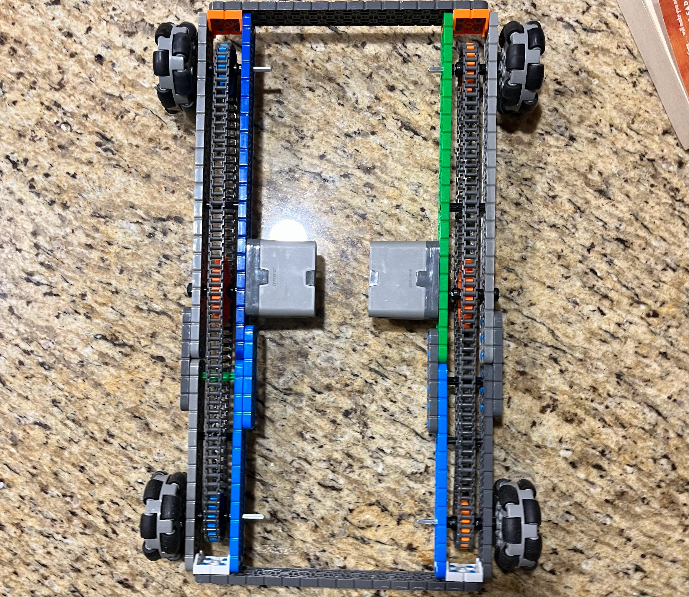
Build Solution
Final Drivetrain
Assembled Drivetrain
This is a side view of the fully assembled drivetrain.
This is a top view of the fully assembled drivetrain.
Now, the drivetrain is fully assembled, with the necessary pieces.
Notes:
9/10/2023

Slide 43
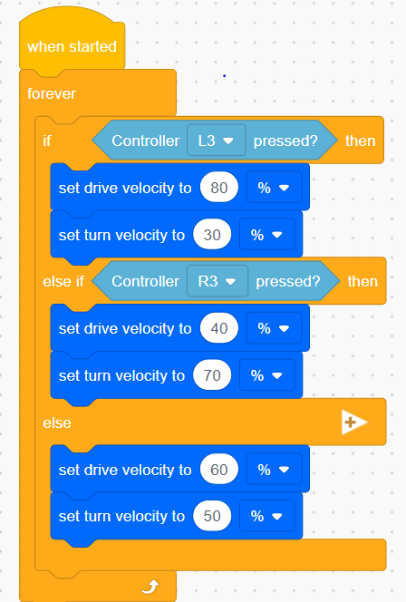
Build Solution
Programming
Goal
We will create a program that will make driving easier and more efficient during competitions to maximize our driving capabilities.
Code
When L3 is pressed on the controller, the robot will be more speed focused. When R3 is pressed, the robot will be more turn focused, and when neither are pressed, the robot will be at 50% speed and turn speed.
Conclusion: Using this code, the robot will be able to maneuver through small spaces when the R3 button is pressed. When the L3 button is pressed, the robot will be able to move faster throughout the field but turn slower. This will be useful when the robot has to go fast in one certain direction.

Slide 44
Test Solution
Gear Ratios
Goal
We will test our final drivetrain to determine if it is efficient and meets our needs.
3:2 Gear Ratio: Final Testing
To test the overall speed and agility of the robot, we have created an obstacle course for our robot. We will see how it maneuvers and how fast it can pass through the course. We are going to test this in time (preferably seconds). Afterwards, we are going to conduct this test 5 times, and average out the time, to determine if this gear ratio is an appropriate and approving option.
3:2 Gear Ratio: Final Testing Chart
 | Test 1 | Test 2 | Test 3 | Test 4 | Test 5 | Avg.
2:3 Gear Ratio | 20.27 Seconds | 20.57 Seconds | 20.16 Seconds | 20.47 Seconds | 20.26 Seconds | 20.35 Seconds
Notes:
8/29/2023

Slide 45
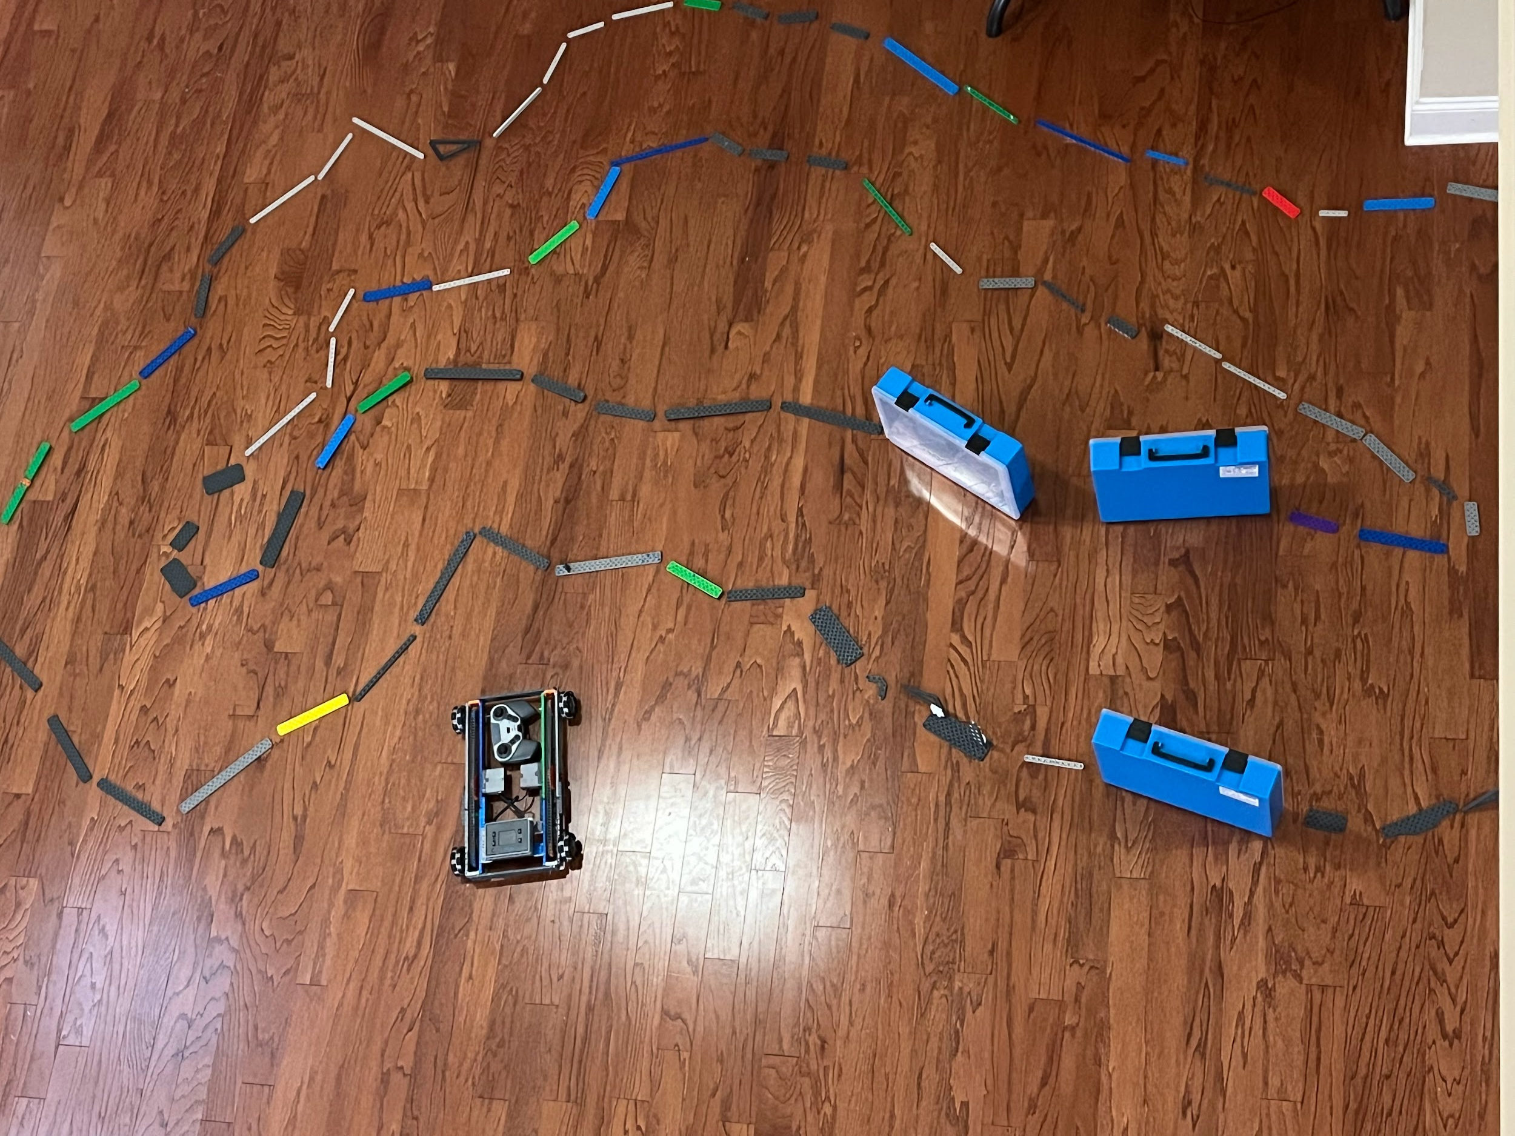
*The blue line shows the path that the robot has to take during the testing period.*
Final Testing: Conclusion
After analyzing the results of the 5 tests. We have come to a conclusion that this gear ratio is very consistent in its efforts. The times for each lap were all in the same second, but just a few milliseconds off. This shows that we made the right choice in deciding to use a 3:2 gear ratio.
Notes:
8/30/2023

Slide 46
DRIVETRAIN TIMELINE
Time Management
Goal
We will create a timeline to manage our time efficiently and finish our robot before the competition takes place. This is our FINAL timeline for building the drivetrain.
Selection & Build Drivetrain Completed: 9/9
Identify Problem: 8/31
Drivetrain Completed: 9/10
Brainstorm Solutions: 9/3
Test Final Drivetrain: 9/10

Slide 47
INTAKE FORECAST
Time Management
Goal
We will create a timeline to manage our time efficiently and finish our robot before the competition takes place. This is our GOAL for building the intake. This timeline will be flexible.
Identify Problem: 9/11
Selection & Build Intake: 9/15
Intake Completed: 9/17
Brainstorm Solutions: 9/12
Test Intake : 9/17

Slide 48
Identify Problem
Intake Build
Goal
We want to create a intake mechanism, that shows effectiveness in the VEX IQ Full Volume Game.
Problem
Solution Requirements/Limits
The problem for intake build is that there is a variety of blocks, and not just one type. This makes it hard to take measurements, because it needs to be compatible with at least ⅔ of the blocks types.
Because of the drivetrain width, the intake needs to be at most: 5.5” wide and 15” tall.
It needs to fit within the drivetrain.
It also cannot add extra width to the robot.
Solution’s Goals
The intake should be able to fit purple and green blocks.
It should be consistent when picking up the blocks.
It should be compact and easy to use
Notes:
9/11 Vishnu

Slide 49
Intake Brainstorm
Intake Build
Goal
We want to brainstorm intake mechanism ideas, based on our game problem, and the solutions we created.
Intake Mechanism Types
Flywheel Intake (36:1 Speed Ratio)
Most common in robots, but a faster version
Motor connected to gears that spin flywheels
Positives | Negatives
Fast Consistent More common | Lots of motor stress More battery usage. Complex programming
Flywheel Intake (18:1 Speed Ratio)
Most common in robots, but a slower version
Motor connected to gears that spin flywheels
Positives | Negatives
Easy to build Less Motor Stress Consistent | Slower than normal More battery usage Complex Programming
Notes:
9/12 Vishnu

Slide 50
Claw/Grabber Mechanism
Uncommon Mechanism
Motor attached to neutral gears that open and close to grab onto pieces
Positives | Negatives
Easy to build 1 Motors Easy to program | No speed and torque ratios Hard to transfer to a disposal area Very uncommon
Notes:
9/12 Vishnu

Slide 51
Intake Sketches
Flywheel Intake
Claw/Grabber Intake
KEY: Blue = Gears ; Yellow = Flywheel
Green = Motors ; Red = Stability
Notes:
9/13 Sanchit

Slide 52
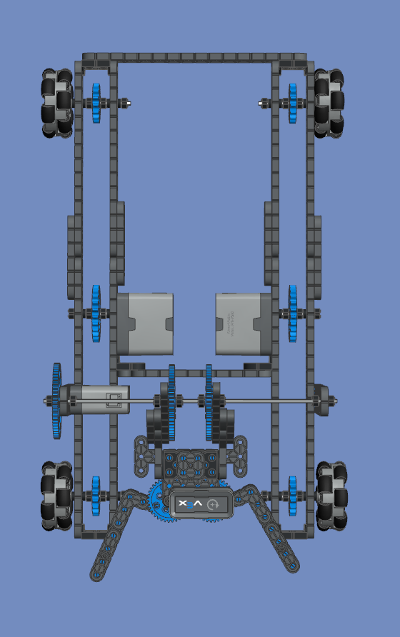
Intake (CAD Models)
Flywheel
Claw/Grabber Mechanism

Slide 53
INTAKE FORECAST
*Updated*
Goal
We will create a timeline to manage our time efficiently and finish our robot before the competition takes place. This is our GOAL for building the intake. This timeline will be flexible.
Identify Problem: 9/11
Selection & Build Intake: 9/19
Intake Completed: 9/23
Brainstorm Solutions: 9/12
Test Intake : 9/23

Slide 54
Select and Plan
Intake Type
Goal
We will choose the best intake mechanism for our robot to maximize efficiency and to meet our needs.
Testing
After brainstorming and building the two types of intake mechanisms, the claw and the flywheel, we will move on to the next step. We will put both of the subsystems through tests that will test:
Speed: How fast can the robot pick up blocks?
Control: How easy is it to pick up blocks?
Size of blocks: What size blocks can the robot pick up?
Notes:
9/8

